Slide 1
Wire Frame Design
Romain Roux
COP 3835

Slide 2
The website be about me and my experience at FIU, from a French student.
The goal of the website is informative first. Since I m the first student from my university in France to come, I could give feedback through the website etc
Website will be composed of 6 pages :
Home page
About me page
Contact me page
2 more tbd (probably one about fiu / my feedback)
All the pages are composed the same way :
Navbar
Page content
Footer
The website will be pretty simple : every page can be reached from any pages and easy to read (not too much information)

Slide 3
Navbar
The navbar got a link to every page of the website.
Footer
The will footer contain contact or short useful information (email / media) .

Slide 4
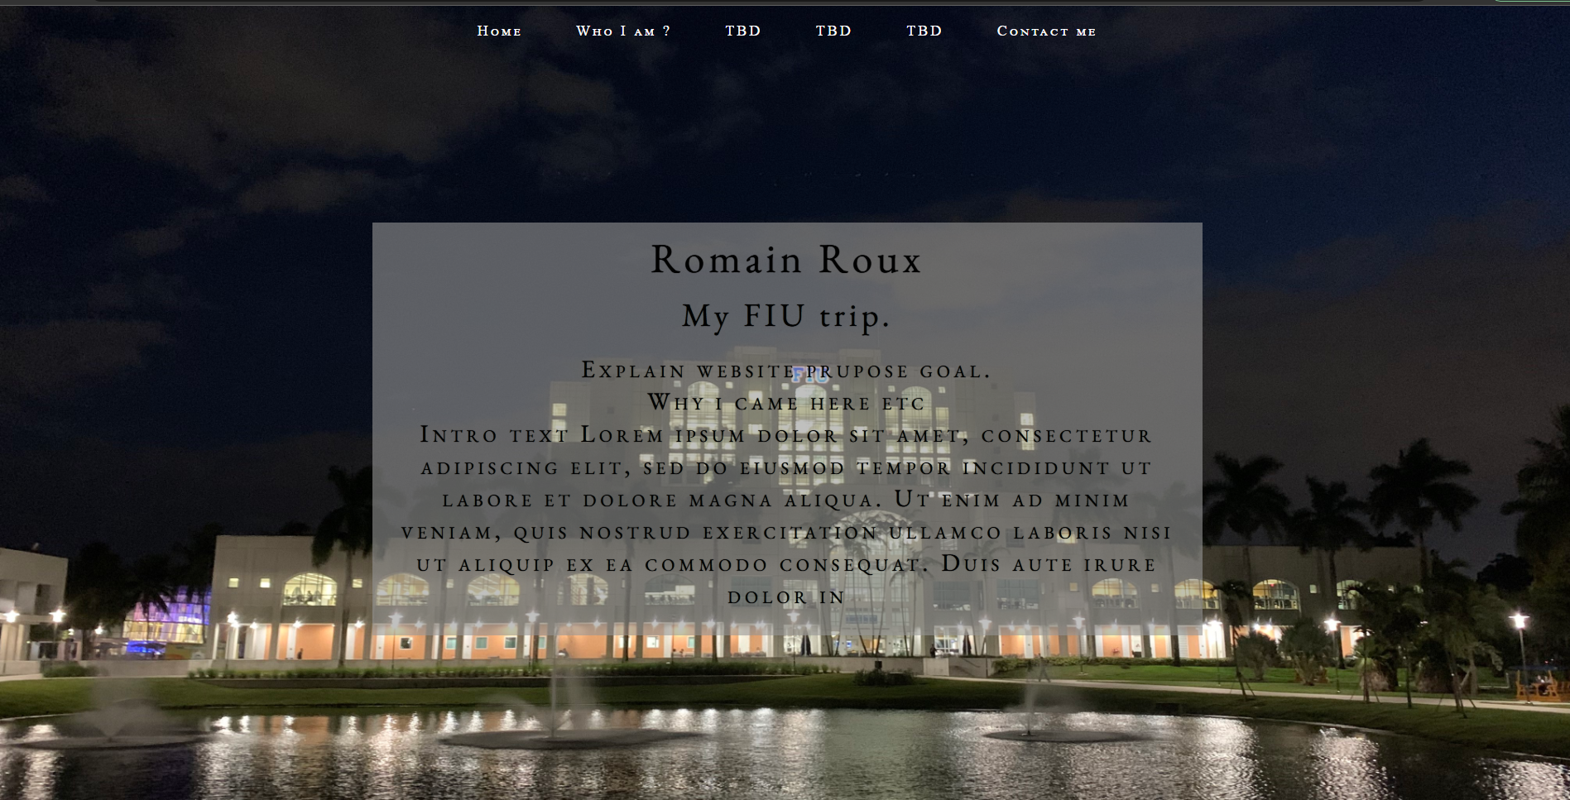
Home page
Explain the purpose of the website and what you can find on it.

Slide 5
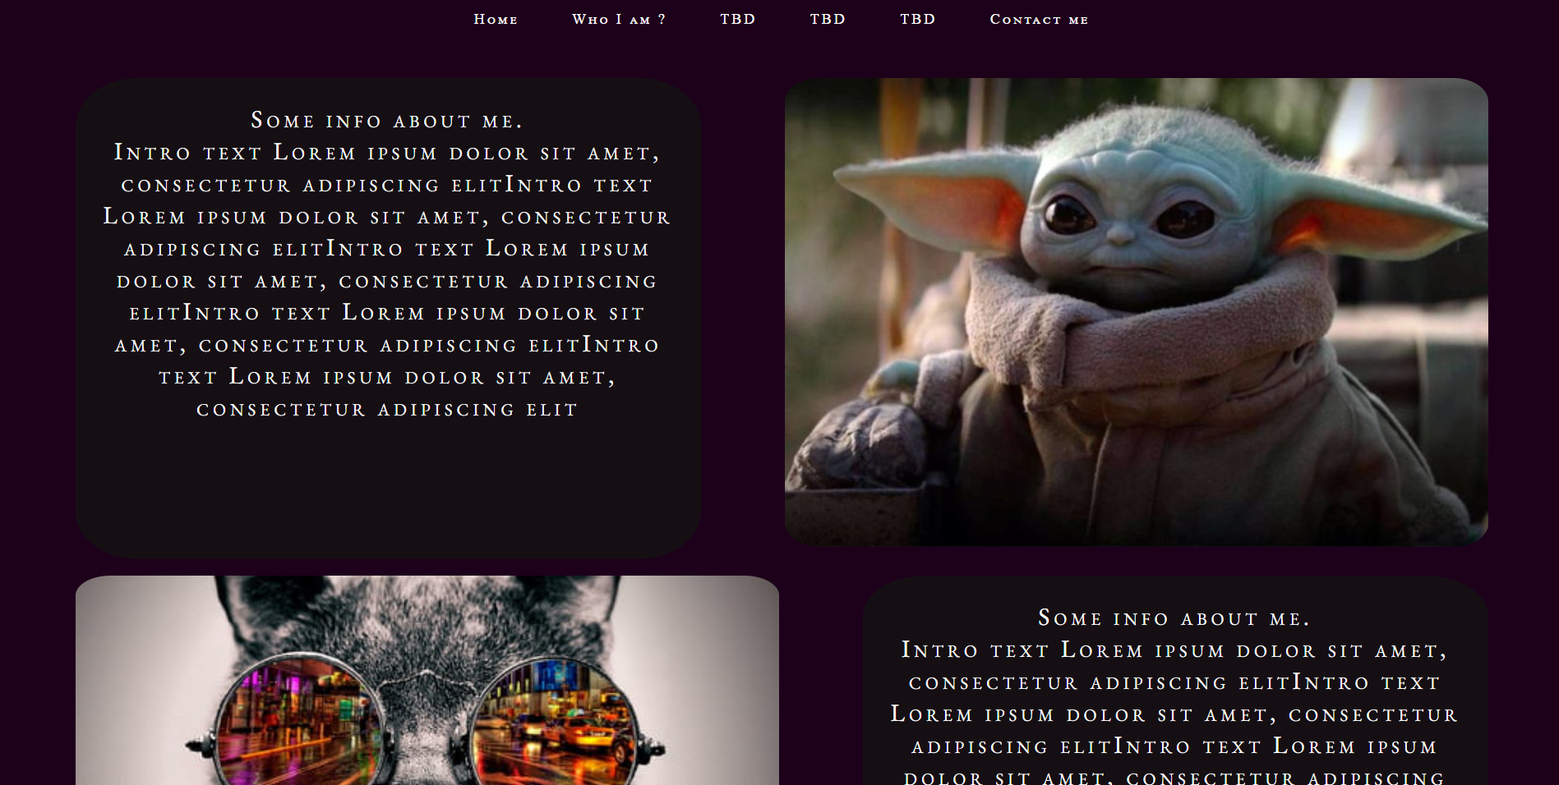
About me page
Explain who I m and what I do at fiu. Include some picture around…. beause its fun.
Pretty cool design I think, easy to read

Slide 6
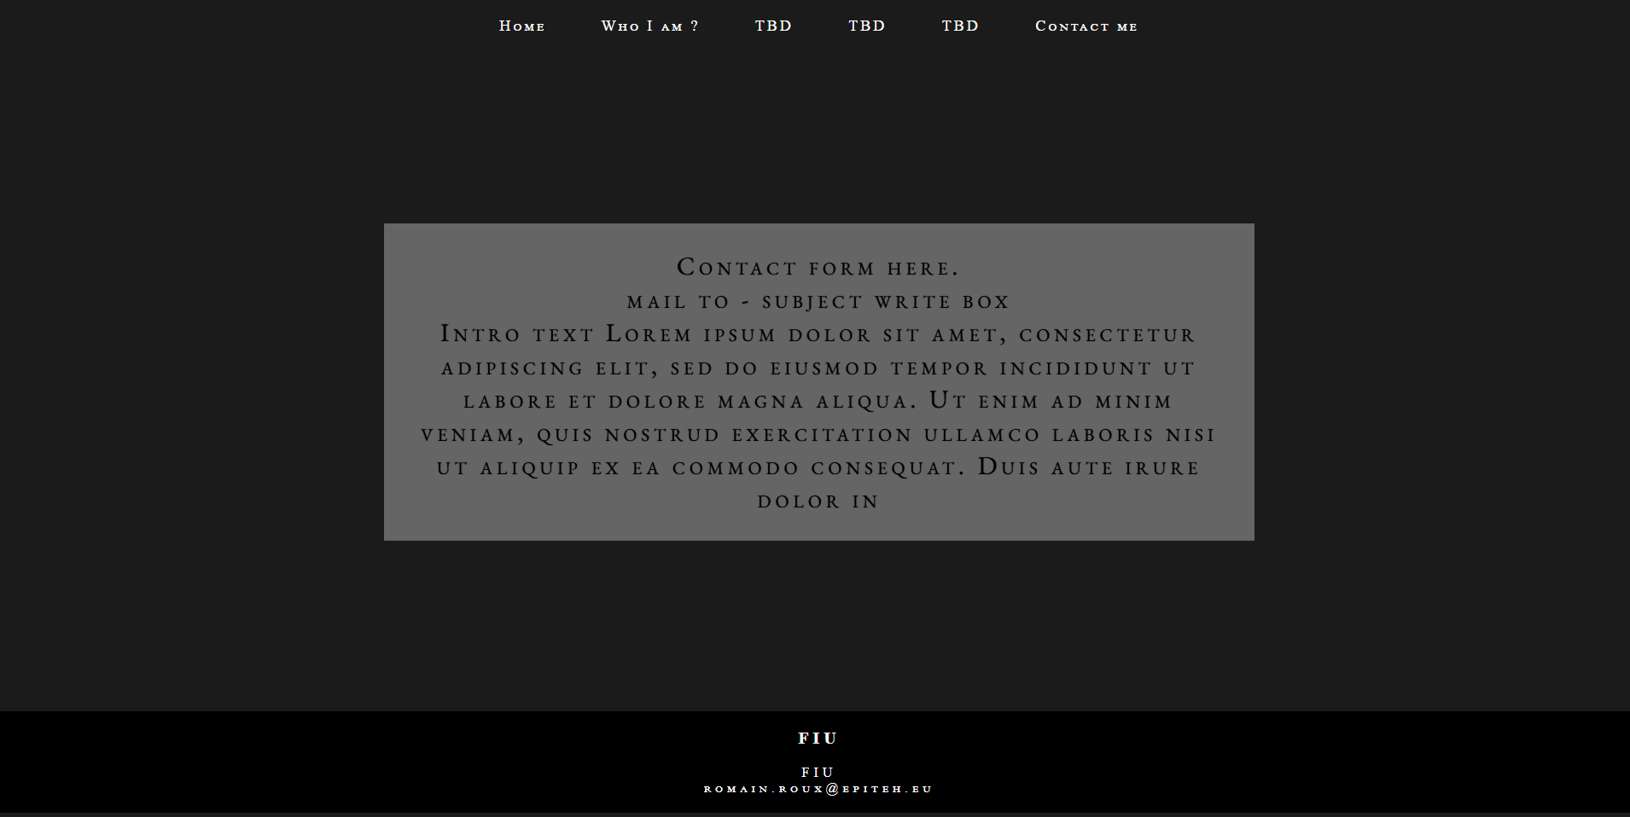
Contact page
Form where user can contact me if he wants to get more information or for anything.
Still need some work on it

Slide 7
Website flowchart
Home
About me
Who I am ?
FIU
My feedback
Contact
Navbar
Navbar
Navbar
Navbar
Navbar
Page content
Page content
Page content
Page content
Contact form
Footer
Footer
Footer
Footer
Footer

